Slide 1
EUROPEAN BIG DATA HACKATHON: COSMOPOLITICS Team Istat: F. Altarocca, F. Amato, F. Brogi, M. Bruno, E. Cerasti, S. Causo, F. De Fausti, B. Guardabascio, P. Pizzo, M. Scannapieco, D. Zardetto
July 2, 2021
International WebWorkshop on Computational Economics and Econometrics

Slide 2
Summary
European Big Data Hackaton
Cosmopolitics: architecture
Analyzing foreign trade via Big Data: integration of new information and perspectives
Evolution of exchanges at the time of Covid-19:
Methodology (Social Network Analysis)
Results
Measuring the impact of Covid-19 on Import and Export:
Methodology (Interrupted Time Series Model)
Results
Demo

Slide 3
European Big Data Hackaton
The European Big Data Hackathon is a biennial event organized by the European Commission (Eurostat) starting from 2017:
It is an event that is part of the NTTS conference
It brings together teams from all over Europe in a competition
The purpose is to create a product that combines official statistics and big data
To bring support to policy makers on a pressing issue that Europe faces.
Aims of the competition
Development of algorithms and use of large amounts of relevant data available
Interaction between developers and data scientists across Europe
Promotion of big data for statistical initiatives in Europe
Production of innovative products and tools, especially for data visualization, to stimulate the use of open data and files for public use.

Slide 4
L'European Big Data Hackathon 2021
Competition policy question:
Create an interactive dashboard to predict and simulate international trade relations in a high-resolution network by product and time
Scenario analysis and support for international trade policies
Ability to represent international global exchange networks
Visualization of relationships for partners, products and means of transportation
Analysis at product level as disaggregated as possible
Scenario simulation for transport interruptions
Further suggested analysis: study of the impact on COVID products, etc.
22 hacking teams
Winners: 1st Italy, 2nd Polond, 3rd Lithuania

Slide 5



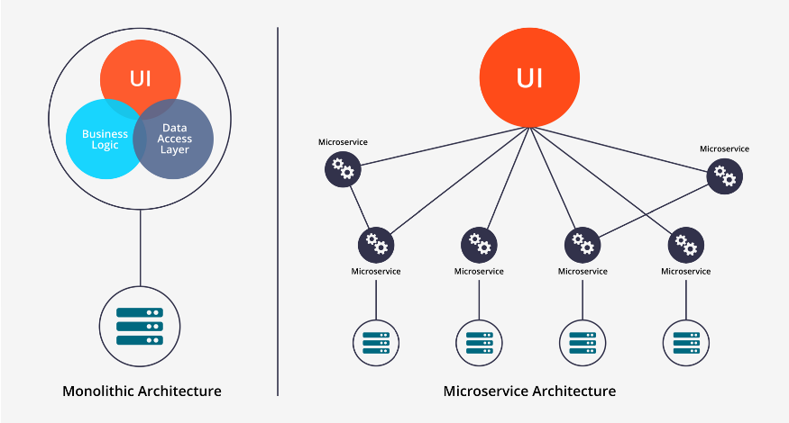




Cosmopolitics: architectural context
Solution
Smart & Light
Dashboard
Heterogeneous processing
Microservices architecture

Slide 6




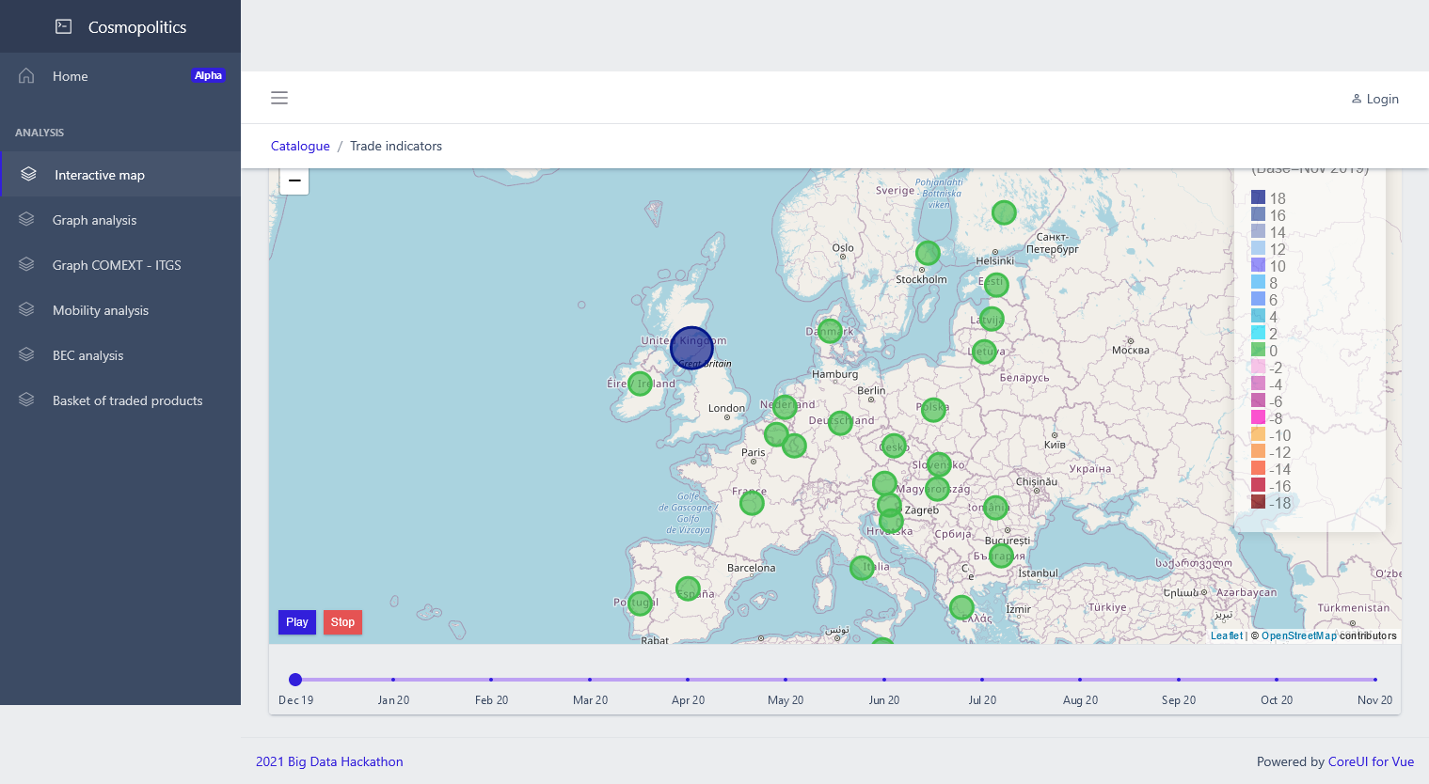





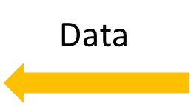








Cosmopolitics: architectural solution
visualization
Data
{JSON}
<Cosmopolitcs UI>
{JSON-Server}
processing
BD Hackathon
<Microservices Back-end>

Slide 7
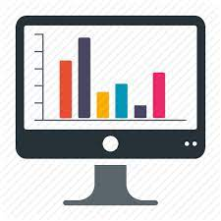

Cosmopolitics: in action
Data Visualization
Data Processing
Data Collection
{JSON-Server}
Embeddable views components
Light components
Easy deploy
Run anywhere
Automated data retrieval

Slide 8




Cosmopolitics: links
http://is2.westeurope.cloudapp.azure.com:8070
https://github.com/istat-methodology/cosmopolitics

Slide 9
Data sources
Integrated use of Open Data of different nature to answer the policy question
Eurostat Sources
Official statistics data on foreign trade produced by the 27 member countries according to harmonized methodologies based on community regulations: maximum temporal granularity (monthly frequency) and merchandise, commercial exchange between individual countries, by mode of transport and by nature of the transaction.
FIGARO experimental statistical tables: inter-country supply, use, input-output tables, produced starting from official data using methods to estimate from the data the globalized structure of production and marketing phenomena.
Source Istat «Hackathon 2021» integration of Eurostat sources
Experimental product extending the globalization structure of the FIGARO experimental tables to the official Eurostat data at maximum granularity
Google mobility open data
Community movement reports: GPS-based big data indicators to measure the restriction policies applied in the containment of the pandemic
COSMOPOLITICS | M.SERENA CAUSO

Slide 10
Integration of sources to answer the policy question
Integration different sources, together with the wealth of information of the sources themselves, allowed the development of dynamic and iteractive analysis tools, highlighting:
The rapid dynamics that, during the pandemic, changed trade flows not only in trading volumes, but also in terms of composition of the basket of goods traded, the centrality in the flows assumed in the moment of crisis by certain countries for specific classes of products
Changes in the "paths" of interconnection between countries, in which "intermediate" countries in the value chains can assume central roles in a phase of trade crisis
The effect of the interruption of bilateral trade for certain modes of transport on the overall flows of certain categories of products
The effect of mobility restrictions for a faster subsequent recovery

Slide 11
Further potential outputs
Although it is developed for a specific focus on the effect of Covid on foreign trade flows, it can be used in order to:
Analyze the temporal evolution of the flows of goods through the structure of the value chains
Studying correlations between trade indicators built on official statistical data and socila phenomena measurable by big data
Allow the policy maker to assess in advance the effect of changes in bilateral relations between countries (logistics or transport investments, increases in foreign investments, etc.)
Further potential use:
Possibility of extention to different statistical domains (analysis of relations betwween countries through multinomial companies, or between territories at national level in the context of productive delocalization).
High versatility in the possibility of interfacing regularly and open-data of different nature to update the databases used.
Limited need for manual intervention

Slide 12
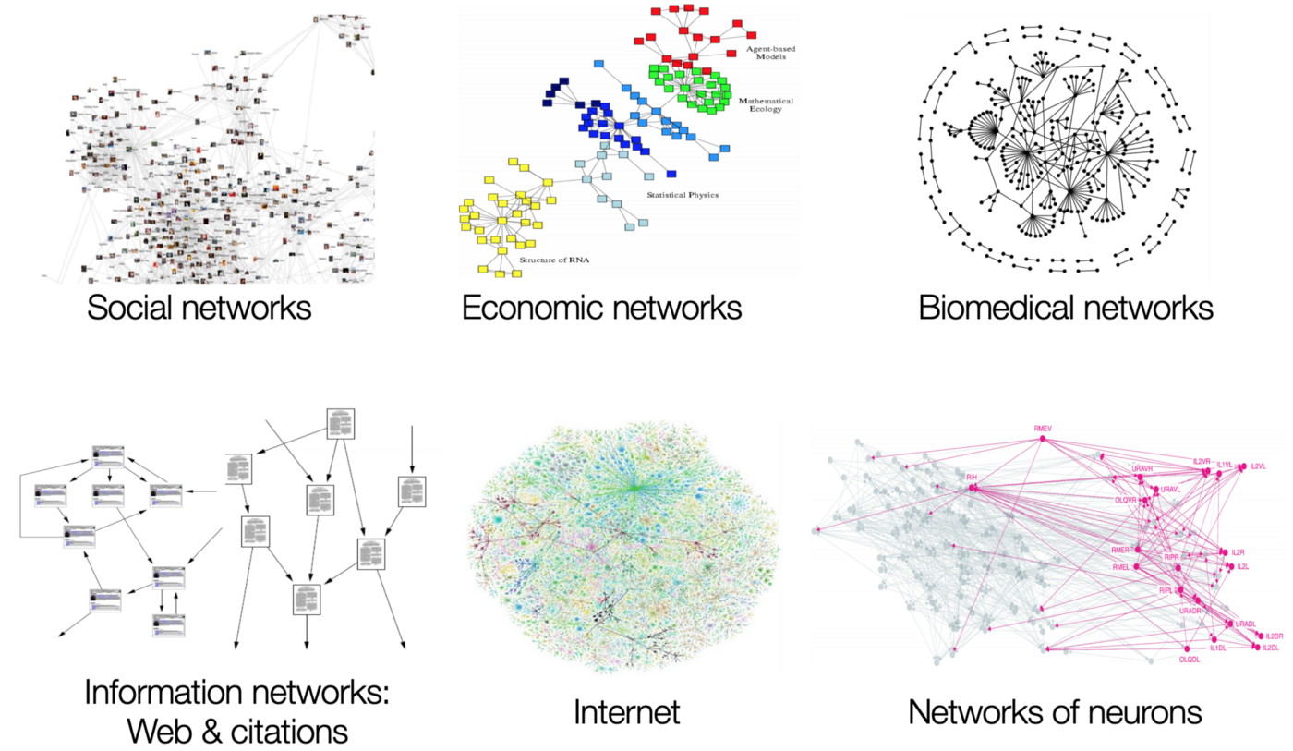
Why Network Analysis
Network Analysis can be applied to several domains of interest.
It focuses on relations, hence it provides insights on dynamics involving interactions between several elements.
It exploits graph theory: graphs are used to model many types of relations, structural dimension, interdependance.
Suitable for analysis of international trade data

Slide 13
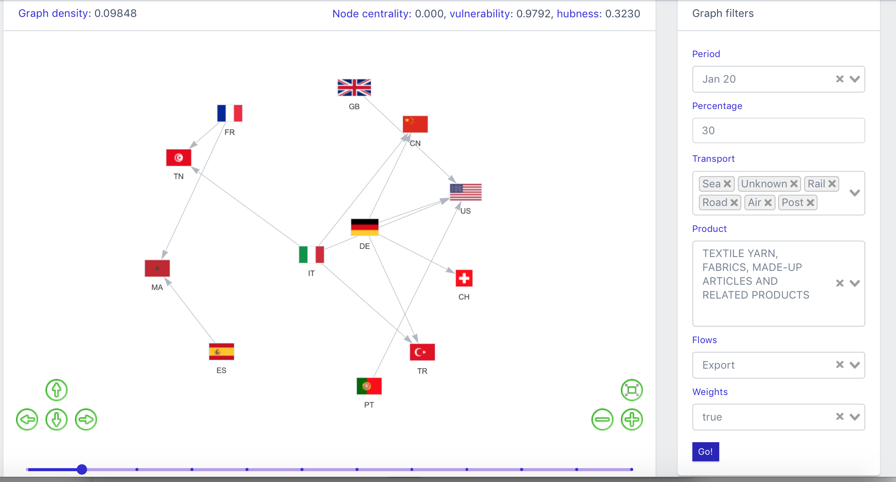
Network Analysis for Trade data
We used “Monthly COMEXT data by Means of Transport” to build the graph of international trade relations and use standard graph measures to characterize the relations structures.
Filters
Period: time period of interest
Percentage: % of the trade flow taken into account to create the graph (cutoff)
Transport: unknown, sea, rail, road, air, post, fixed mechanism, inland waterway, self propulsion. (from Comext database)
Product: one product of interest or all together
Flow: Import or Export
Weight: True or False for weighted or unweighted graph (amounts traded)
Once all the filters are instantiated a graph is built and visualized.
Relative positions are given by the “Spring layout algorithm”.

Slide 14
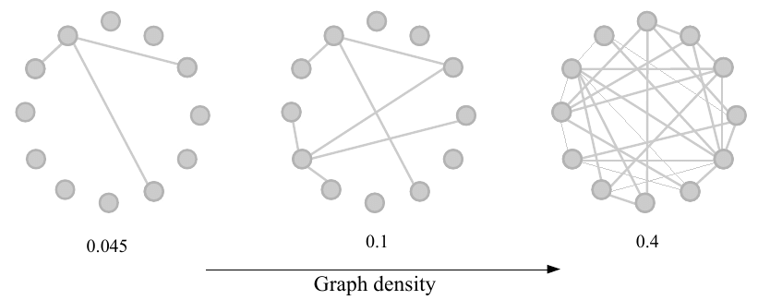
Network Analysis for Trade data
Centrality measures are calculated and displayed in the dashboard:
Product spread: it matches the density of the graph and represents how much the product is spread through the graph.
Vulnerability: (1-indegree centrality) for each country. It conveys the message that a country receiving a product from several countries is less dependent on singles countries for the product supply.
Exportation strength: it matches the outdegree centrality for each country.
Hubness: it matches the betweenness centrality of the countries.
GRAPH DENSITY
The dashboard allows to visualize different graphs and measures for several combination of filters values.

Slide 15
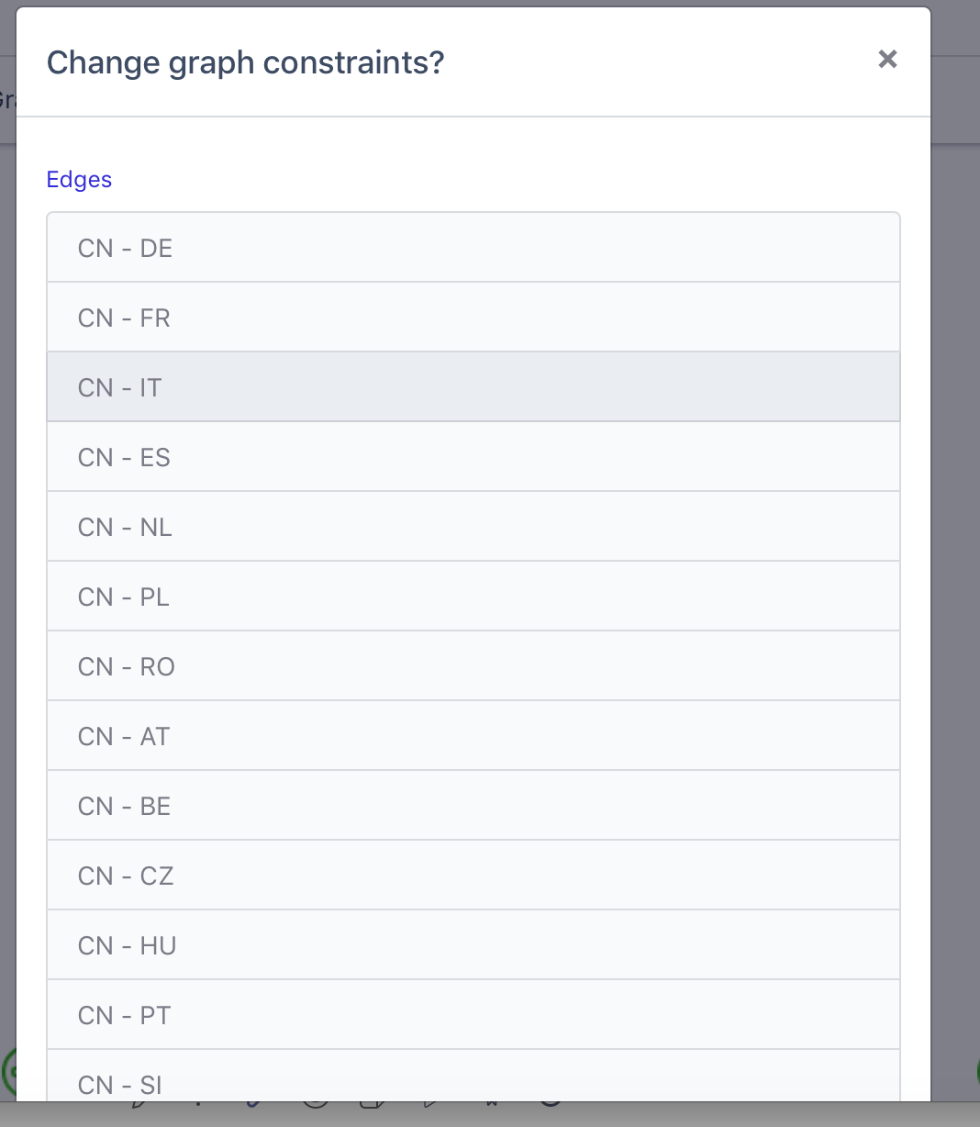
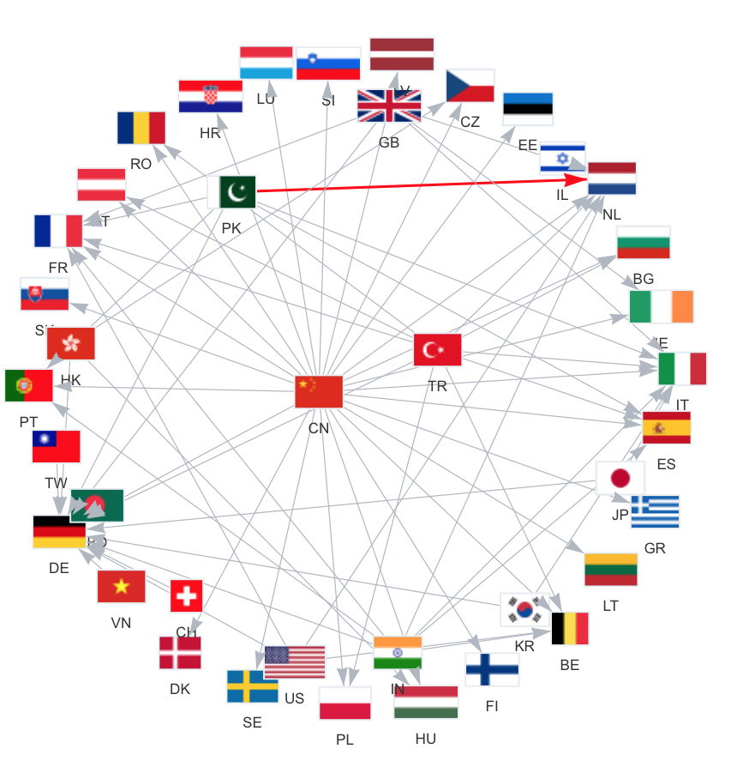
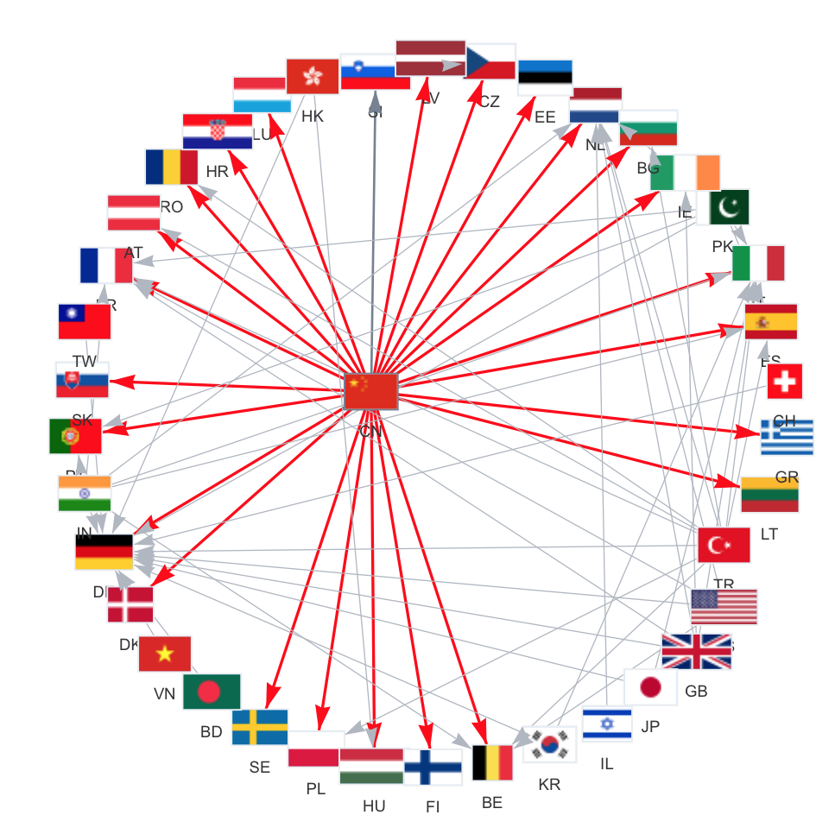
Results – Scenario Analysis and Changes Detection
SCENARIO ANALYSIS
The dashboard allows to delete one or more links from the graph and see how it and its measures changes. That allows to detect changes and to evaluate effect of actions (political and economical decisions) in scenario analysis.

Slide 16
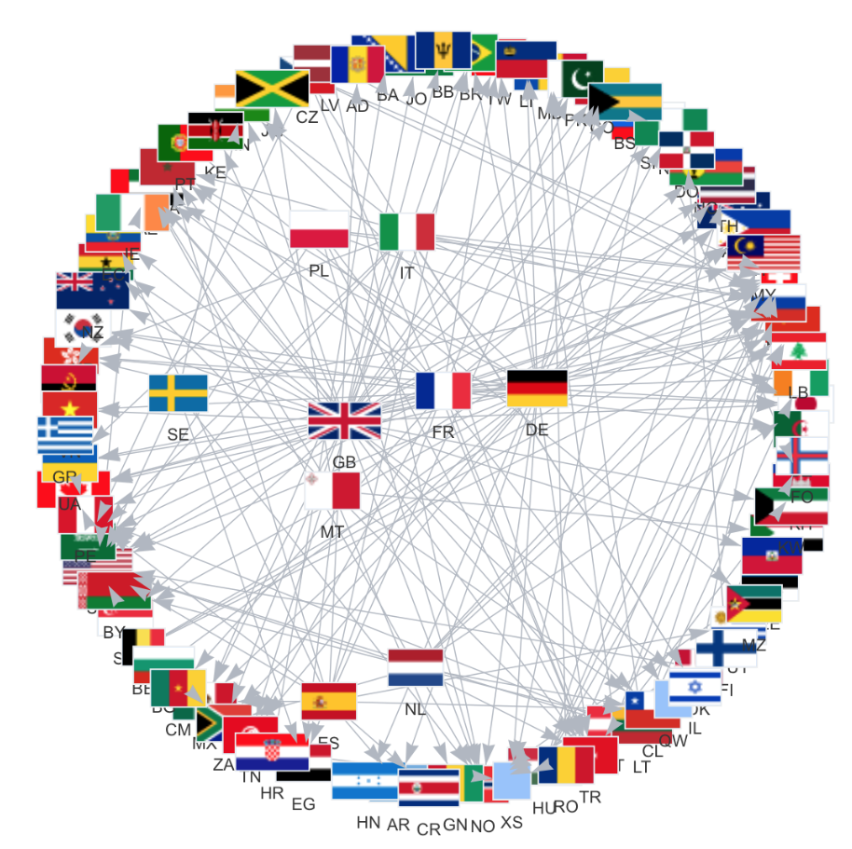
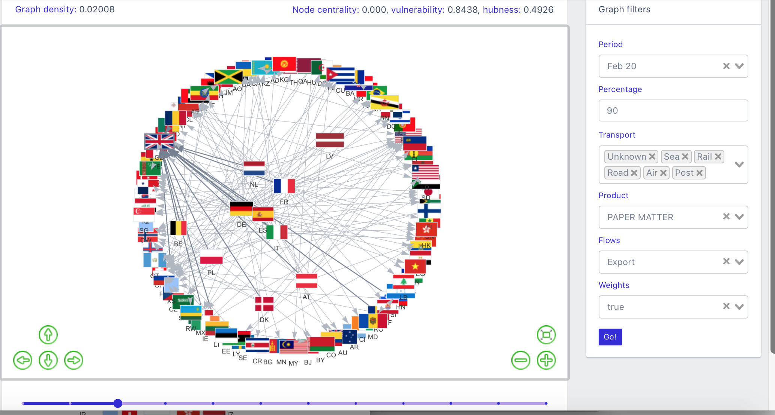
Changes Detection – Brexit effect
February - March 2020
It shows the “Brexit” effect, with the change of the relative position of the Great Britain in a more peripheral area of the graph with respect the European countries.
January 2020
February 2020
Brexit
effect

Slide 17
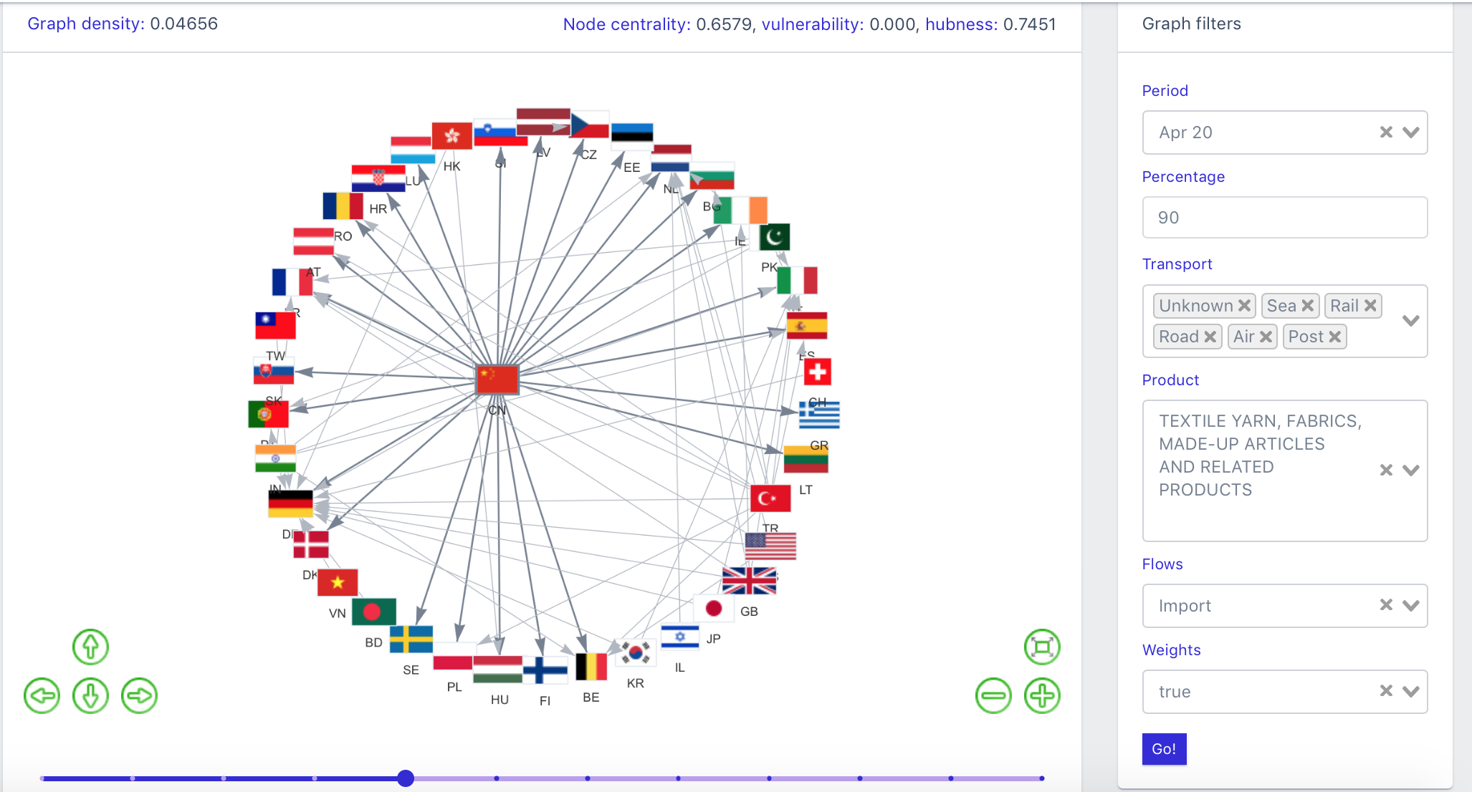
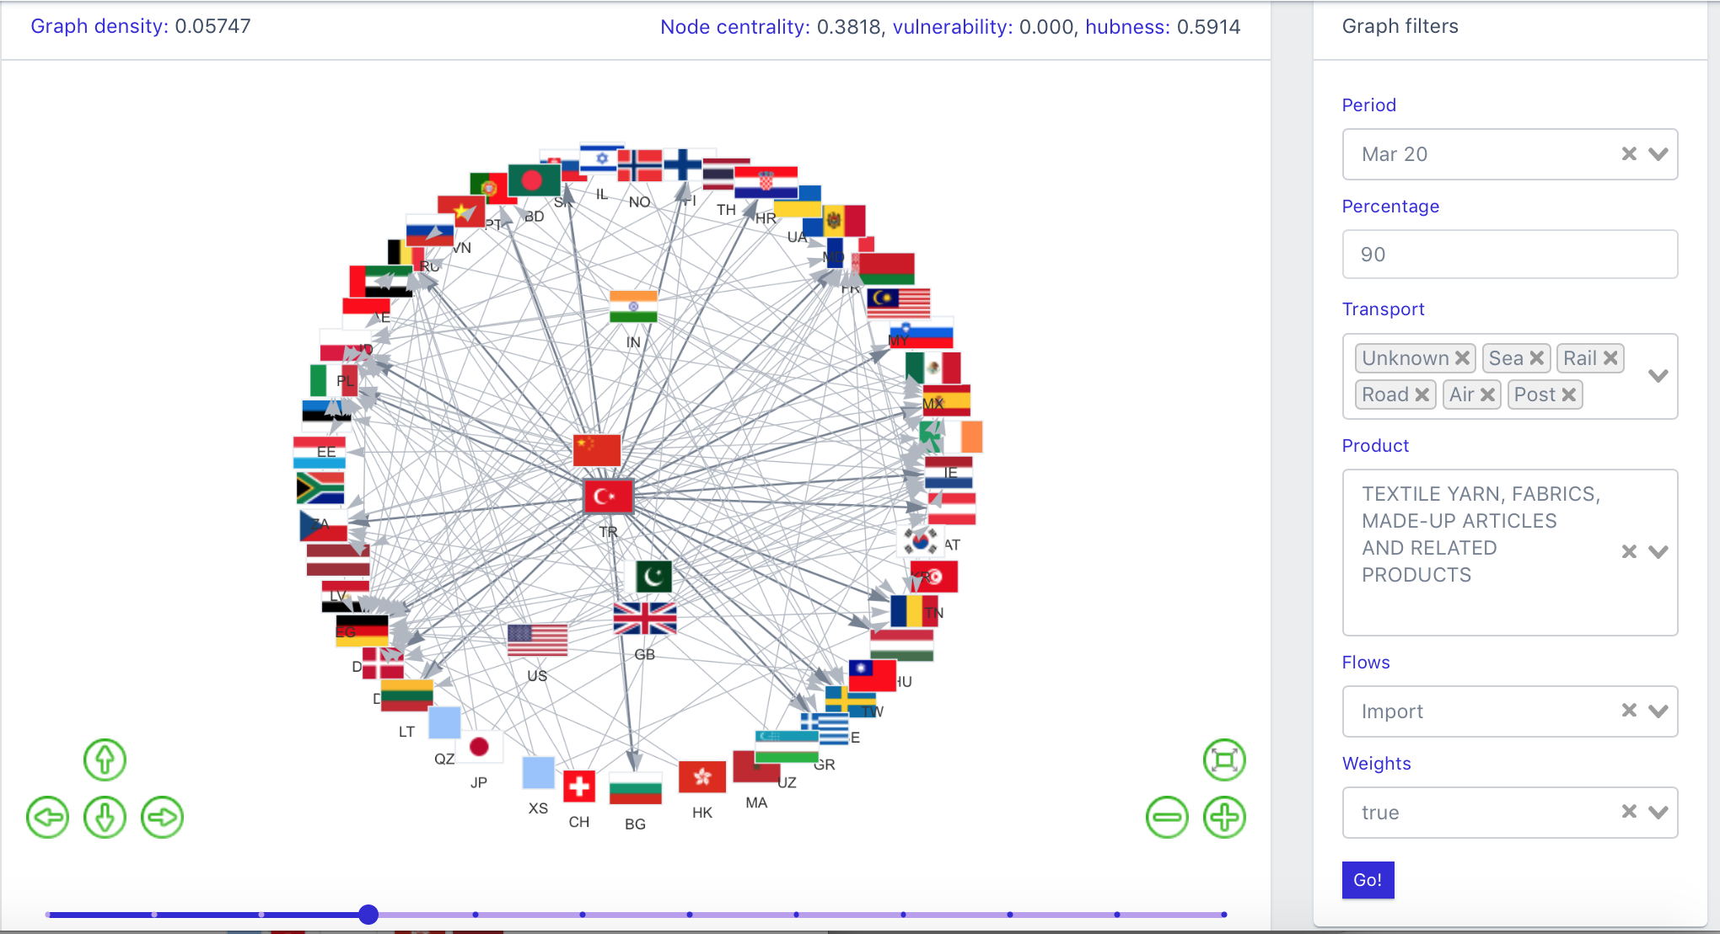
Changes in the network due to the pandemic - China case
March – April 2020
Effect of the pandemic: change of the role of China in the world trade in textile artifacts, due to the sale of masks.
China takes a more central role in the graph: increase of the “centrality” measure for China.
March 2020
Centrality=0.38
April 2020
Centrality=0.66

Slide 18
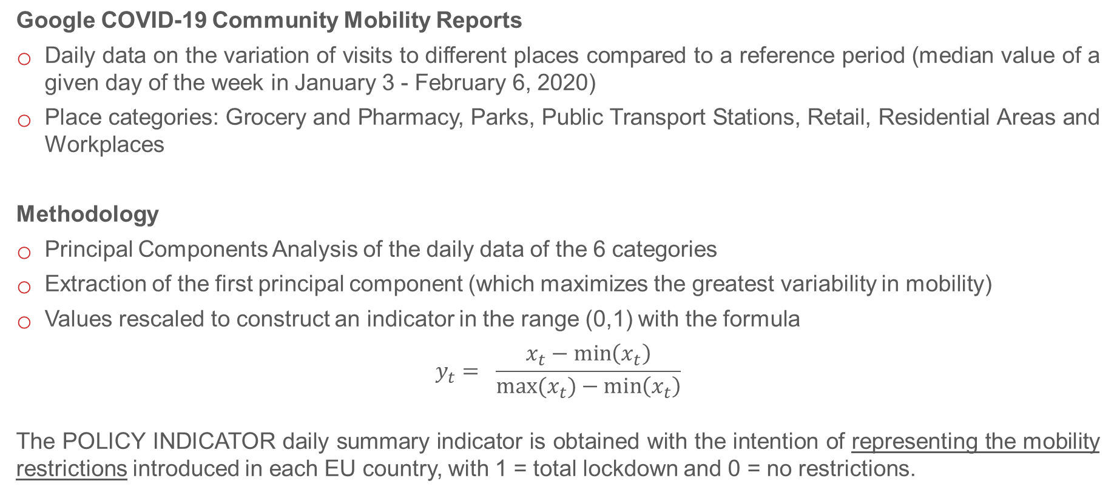
Mobility analysis
Google COVID-19 Community Mobility Reports
Daily data on the variation of visits to different places compared to a reference period (median value of a given day of the week in January 3 - February 6, 2020)
Place categories: Grocery and Pharmacy, Parks, Public Transport Stations, Retail, Residential Areas and Workplaces
Methodology
Principal Components Analysis of the daily data of the 6 categories
Extraction of the first principal component (which maximizes the greatest variability in mobility)
Values rescaled to construct an indicator in the range (0,1) with the formula
$$y_{t}= \frac{x_{t}−\min\left(x_{t}\right)}{max⁡(x_{t})−\min\left(x_{t}\right)}$$
The POLICY INDICATOR daily summary indicator is obtained with the intention of representing the mobility restrictions introduced in each EU country, with 1 = total lockdown and 0 = no restrictions.

Slide 19
Risultati

Slide 20
Risultati

Slide 21
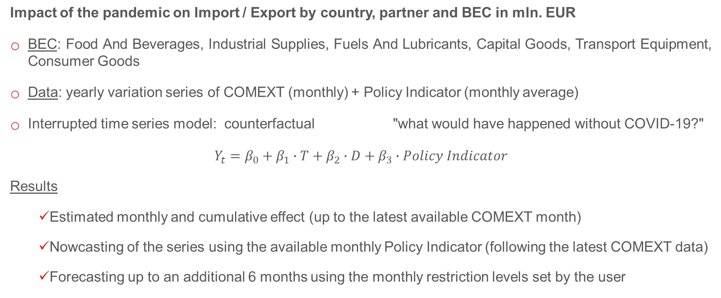
Broad Economic Categories (BEC) analysis
Impact of the pandemic on Import / Export by country, partner and BEC in mln. EUR
BEC: Food And Beverages, Industrial Supplies, Fuels And Lubricants, Capital Goods, Transport Equipment, Consumer Goods
Data: yearly variation series of COMEXT (monthly) + Policy Indicator (monthly average)
Interrupted time series model: counterfactual "what would have happened without COVID-19?"
$Y_{t}=β_{0}+β_{1}∙T+β_{2}∙D+β_{3}∙Policy Indicator$
Results
Estimated monthly and cumulative effect (up to the latest available COMEXT month)
Nowcasting of the series using the available monthly Policy Indicator (following the latest COMEXT data)
Forecasting up to an additional 6 months using the monthly restriction levels set by the user

Slide 22
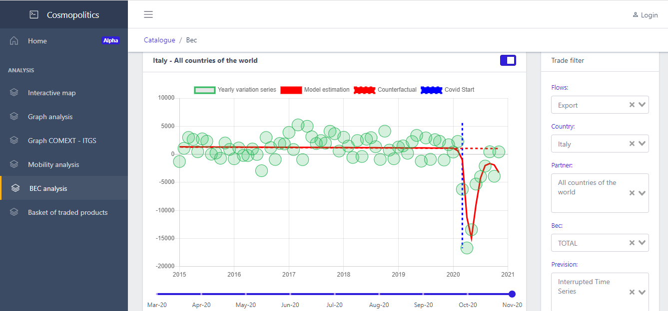
Estimated monthly and cumulative effect

Slide 23
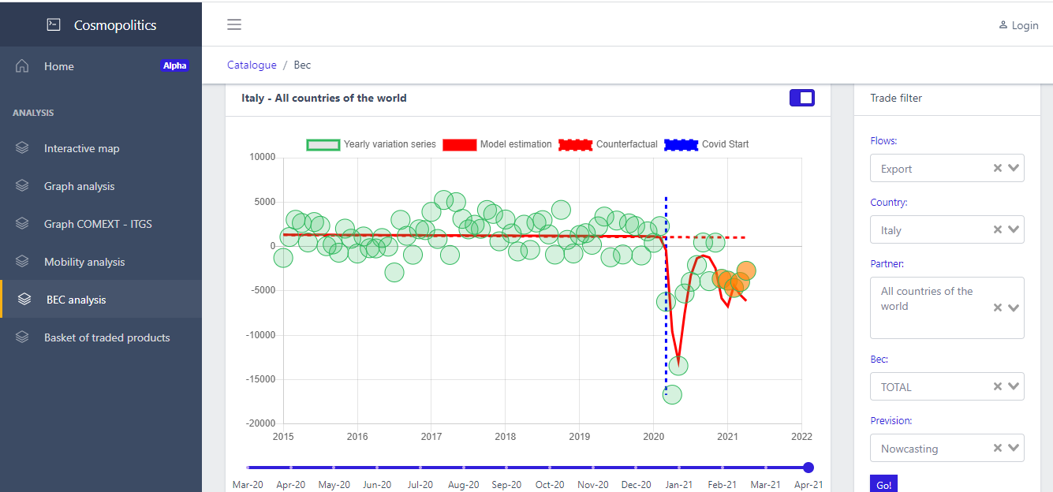
Nowcasting

Slide 24
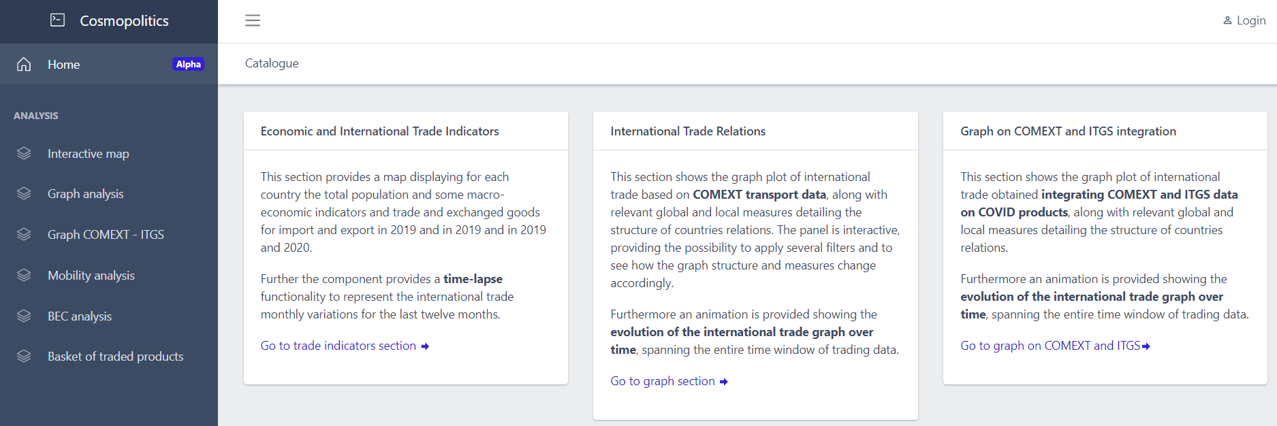
Demo
http://is2.westeurope.cloudapp.azure.com:8070/catalogue

Slide 25
Thank you…

